Slide 1

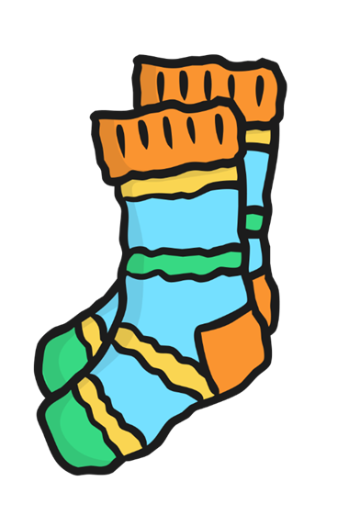


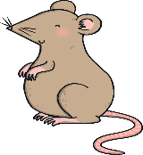

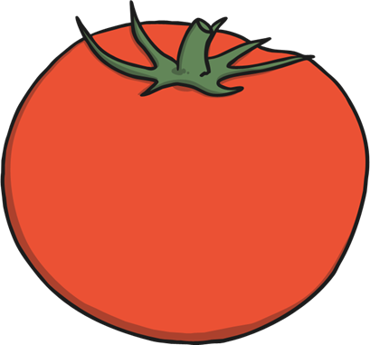
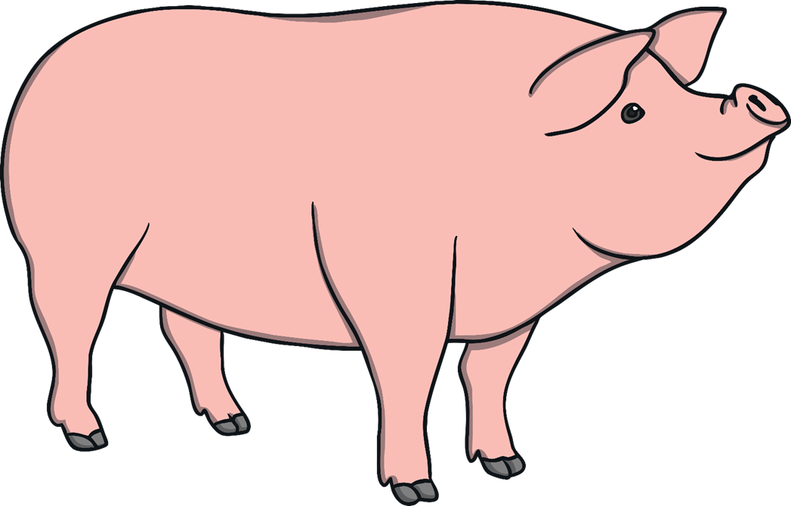





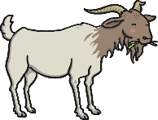







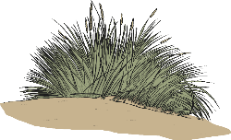


Phase 2 sound mat
s
a
t
p
i
n
m
d
g
o
c
k
ck
e
u
r
h
b
f
ff
l
ll
ss

Slide 2
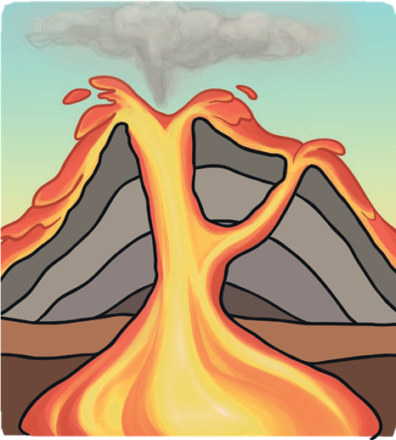

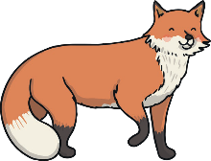








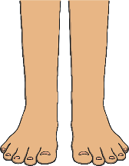









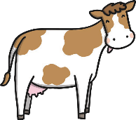





Phase 3 sound mat
j
v
w
x
y
z
zz
qu
ch
sh
th
ng
ai
ee
igh
oa
oo
oo
ar
or
ur
ow
oi
ear
air
ure
er

Slide 3


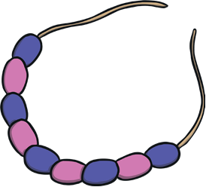









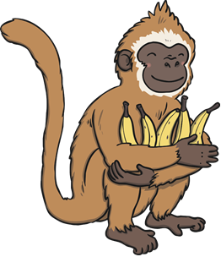




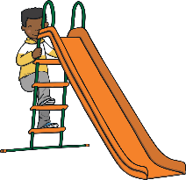
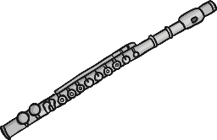



Phase 5 sound mat
ay
ou
ie
ea
oy
ir
ue
ue
aw
wh
ph
ew
ew
oe
au
ey
a_e
e_e
i_e
o_e
u_e
u_e

